Slide 1

Running Apache Spark

Slide 2

Where we were at
Assessed that kubernetes looks like best option for running Spark
Set up a single node kubernetes cluster (Minikube)
Run example spark job through Minikube

Slide 3
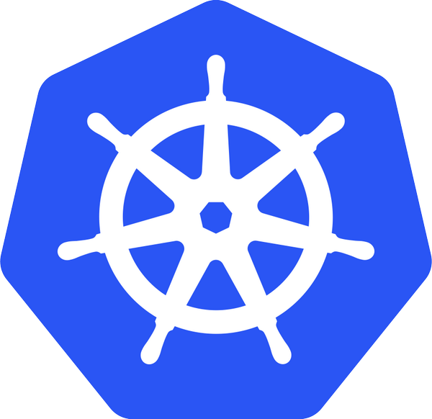
Overview of this sprint
Setting up a kubernetes cluster of VMs
Investigate using the Kubernetes API
Using helm (package manager for kubernetes) to install spark operator
Extending the kubernetes API with the spark operator
Running a spark job through the Spark operator
Mounting volumes from outside of the cluster (In progress)

Slide 4
Setting up a kubernetes cluster of VMs (challenging)
Majority of issues due to networking and permissions
- Need an overlay network across all nodes
- IP tables, service accounts and RBAC authorisation configured
- ensure Kubernetes service traffic is routed over correct network interface
Certain combinations of OS and overlay networks don’t work together. Most stable combination seems to be Weave and CentOS

Slide 5
Using Spark on Kubernetes
Need to use spark operator (Permission issues when run independently)
Helm to install Spark operator
Spark operator acts as a proxy dealing with permission issues for you
Extends Kubernetes API to include spark applications
API can be controlled directly, through kubectl or using clients (e.g. python client, demo at the end)

Slide 6
Kubelet/docker
Kubelet/docker
Kubelet/docker
Master
Worker1
Worker2
Kube proxy
tiller
Spark executor
Kube system pods
Spark operator
Kube proxy
Kube proxy
Api server
tiller
Spark driver
Weave
Weave
Weave
Kubernetes cluster
Laptop
Kubectl
Code
Helm

Slide 7
Using Spark on Kubernetes
Application is defined in yaml file which includes resource allocations
Points to spark job code and mounts any volumes
Permitted volumes: hostPath, persistentVolume or emptyDir
Should also be able to communicate directly with S3 storage (Investigation in progress)

Slide 8
Demo using web App with python client to control job

